Slide 1
Operating System Review

Slide 2
System Software
The programs that control and maintain the operation of the computer and its devices
The two parts of system software are the Operating System (OS) and utility programs.
Operating system (OS) (sometimes called the platform) coordinates all activities among computer hardware resources, applications and the user.
Utility programs are used to maintain the health of the operating system.

Slide 3
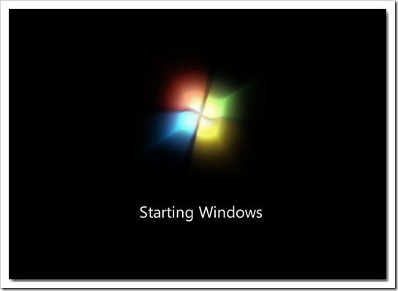
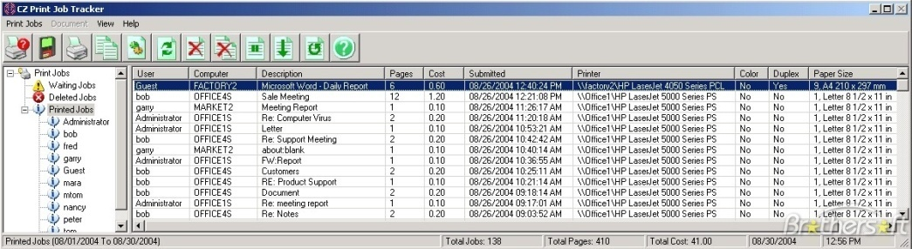
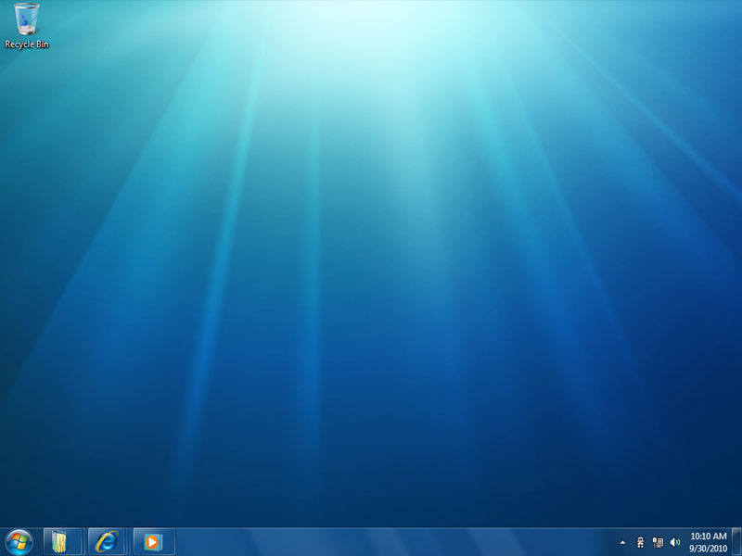
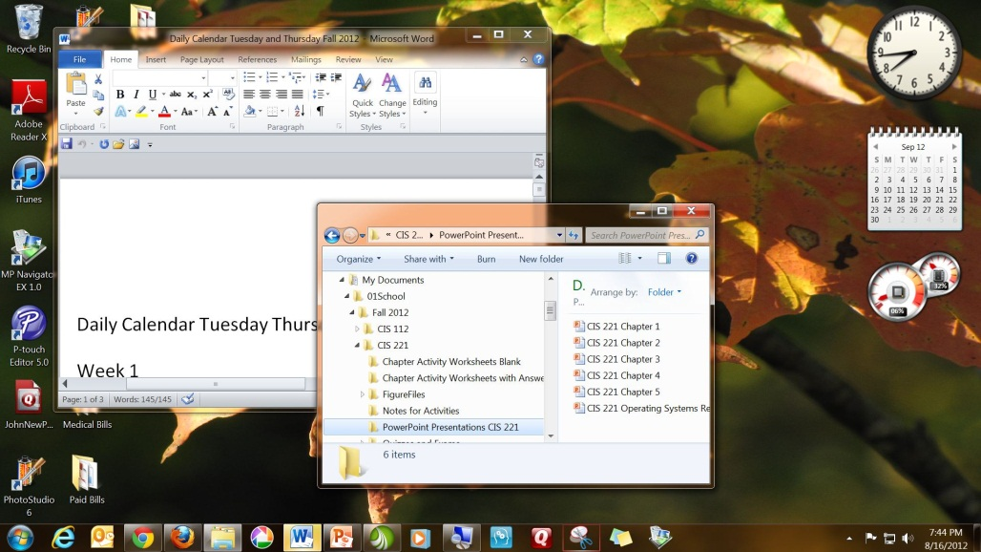
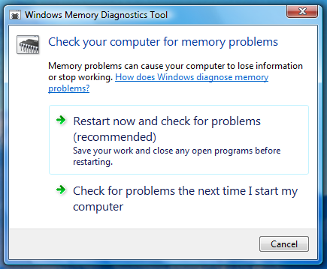
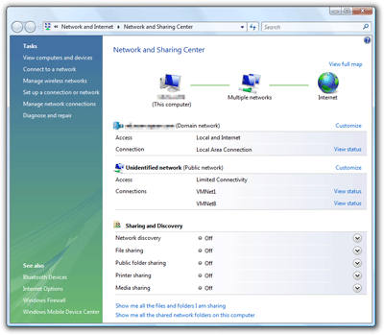
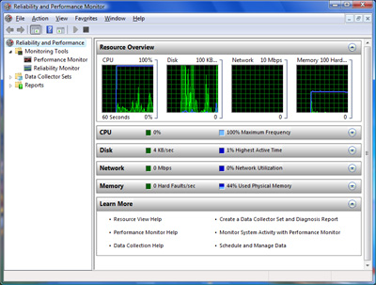
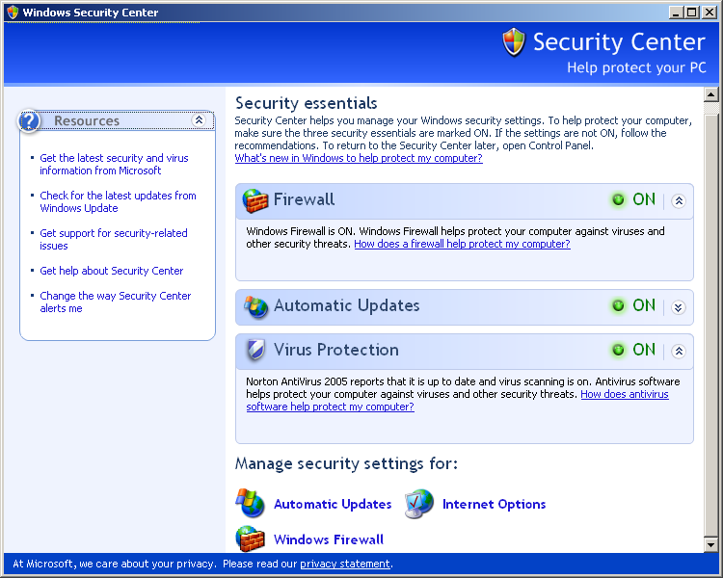
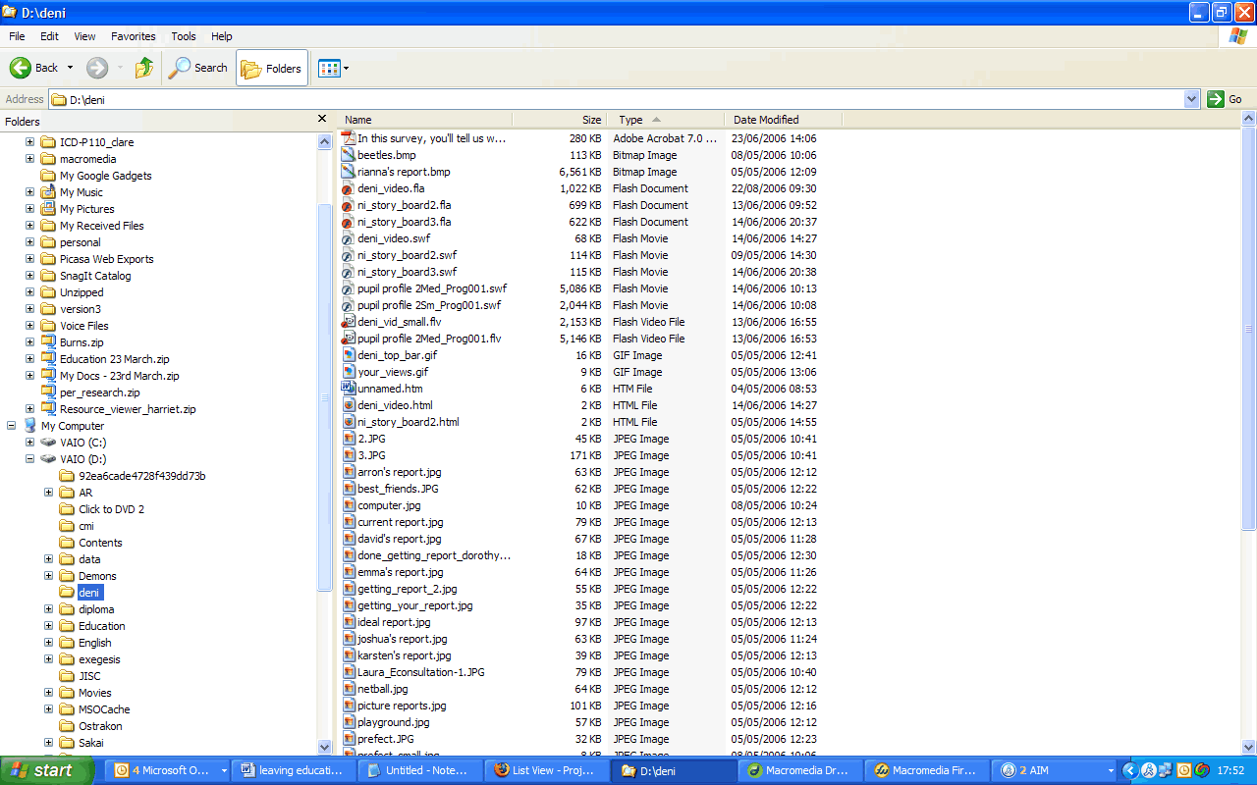
Operating System Functions
start up the computer
provide user interface
manage programs
manage memory
schedule jobs and
configure devices
control a network
administer security
Provide file management and other utilities
monitor performance

Slide 4
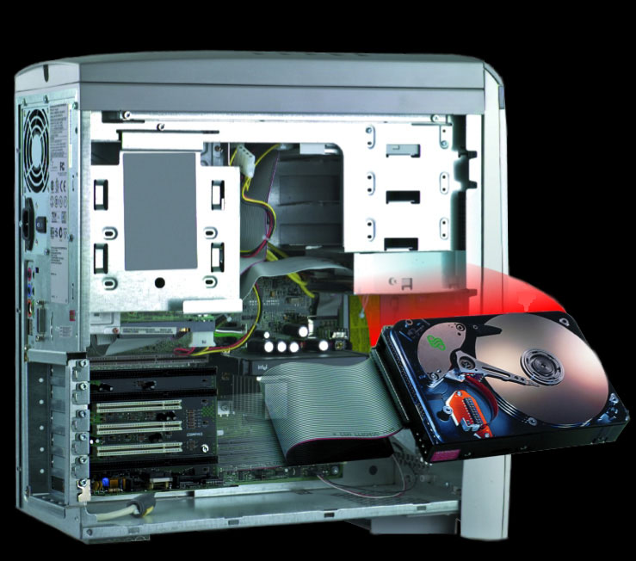
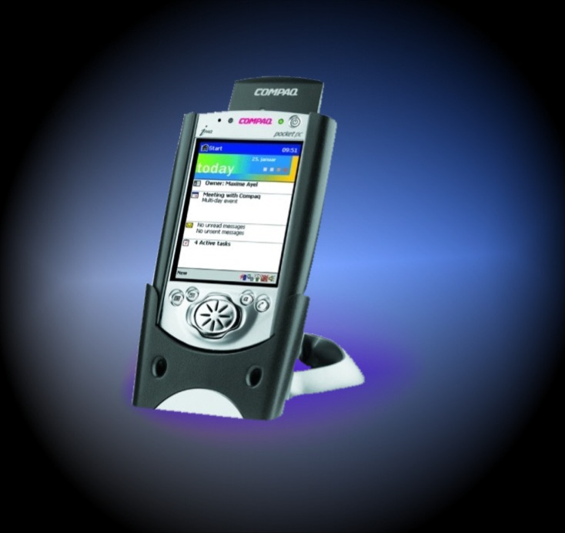
Operating Systems Location
on the hard drive of most PC and laptops
or on ROM chips in most hand held devices

Slide 5
Operating System Start-up
Starting or restarting a computer is called Booting
There are two ways of booting a computer

Slide 6
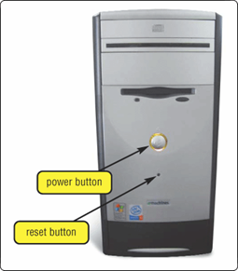
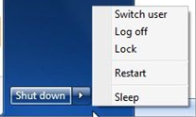
Operating System Start-up
cold boot
Process of turning on a computer after it has been powered off completely
warm boot
Process of restarting a computer that is already powered on

Slide 7
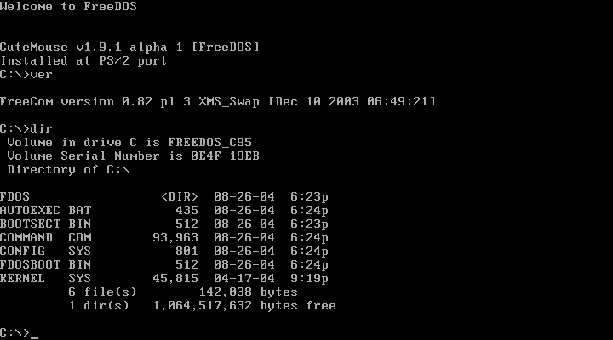
The User Interface
Controls how you enter data and instructions and how information is displays on screen
Two Types
Command line
Graphic User Interface (GUI)

Slide 8
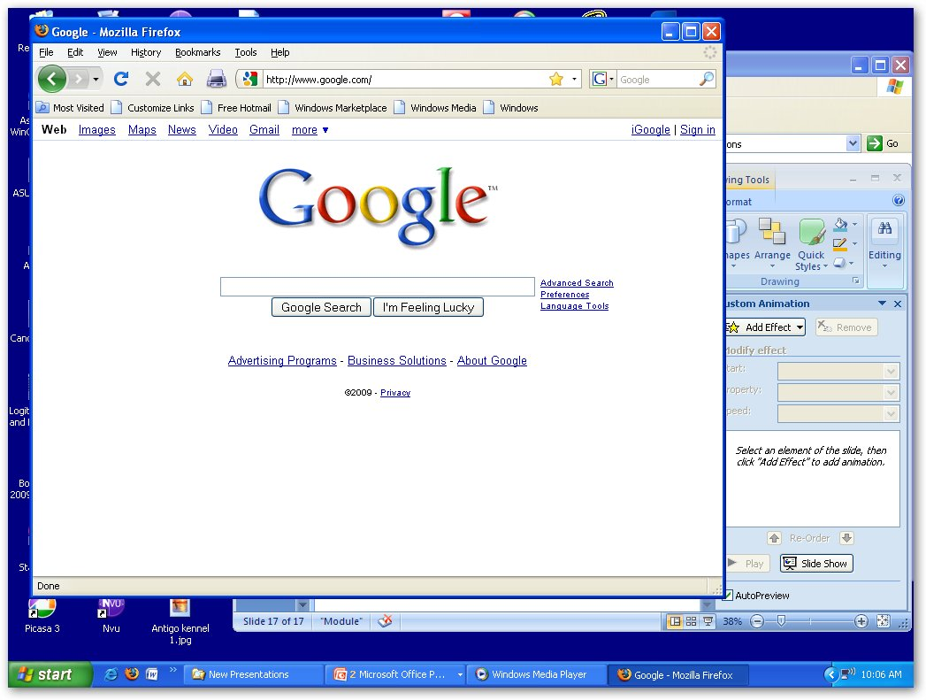
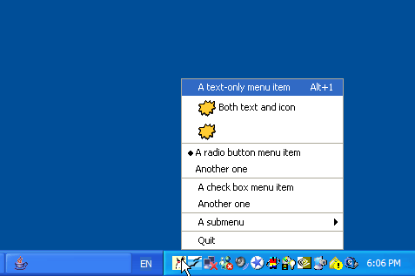
OS Functions – Multitasking
The operating system can have more them one program running at the same time.
Programs run in the foreground are currently in use.
All other programs run in background

Slide 9
OS – Memory Management
As more programs are started more memory is needed to have them available for use
OS
Internet Explorer
Microsoft Word
Photo Studio
PowerPoint
When you close an application memory is released for use
PowerPoint
Photo Studio
Microsoft Word
Memory
Internet Explorer
Operating System and Start-up Programs

Slide 10
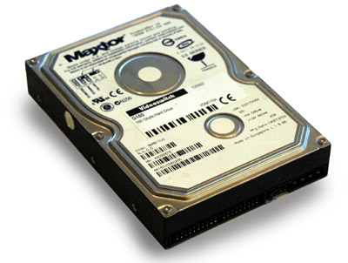
OS – Virtural Machines
Virtual memory (VM) management allocates portion of hard disk to function like RAM
This occurs when the amount of information that needs to be accessed by the CPU exceeds the amount of memory the PC contains.
PowerPoint
Photo Studio
Microsoft Word
Memory
Internet Explorer
Operating System and Start-up Programs

Slide 11
Opreating Systems - Jobs
A job is an operation that the processor handles.
Job scheduling is a dynamic process.

Slide 12
Opreating Systems - Jobs
job
An operation the processor manages
transferring items from storage to memory and from memory to storage
receiving data from an input device
sending information to an output device
processing instructions

Slide 13
Operating Systems – Configuring Hardware
When the OS starts up it must find and configure all of the hardware attached to the PC
It does this by using device drivers
This is a small program that tells the operating system how to configure and communicate with each peace of hardware.
Each device attached to a PC has a unique driver
These drivers are either found in the OS system or come with the hardware on a CD/DVD disk.

Slide 14
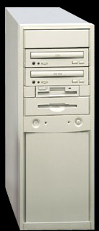
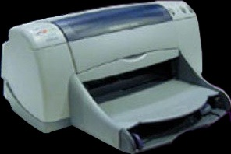
Operating System - Drivers
device driver

Slide 15
Operating Systems - Spooling
Spooling is used to control the process of printing.
Print jobs are sent to a buffer instead of directly to printer, where print jobs wait their turn

Slide 16
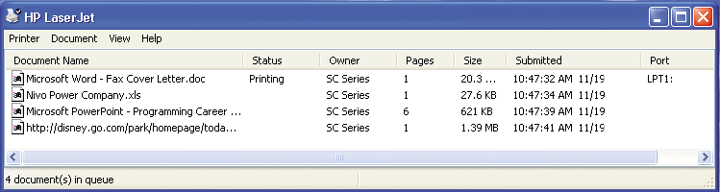
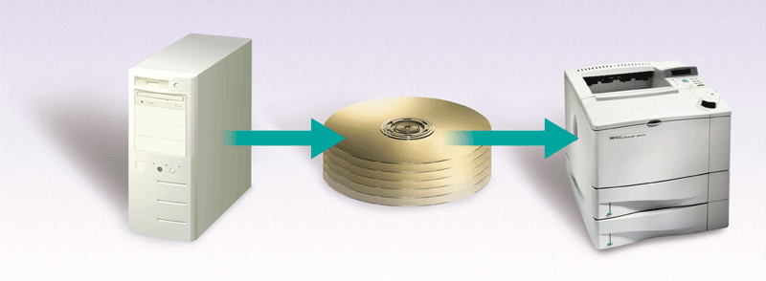
Operating Systems - Spooling
print spooler application
print job
print queue

Slide 17
Types of Operating Systems
Network
Embedded
Stand-alone

Slide 18
Network Operating System
There are a number of network operating systems
These systems are designed to link multiple computers and peripherals together
There systems produced by Microsoft, Sun and other companies
They can be based on Windows, Unix and Linux.

Slide 19
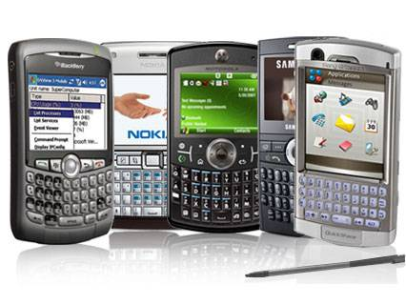
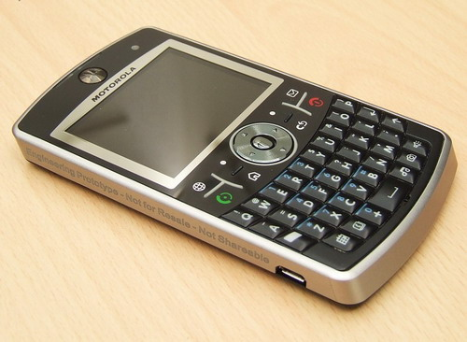
Embedded Operating Systems
Operating systems for mobile devices

Slide 20
Utility Programs
A system software that allows the user to perform maintenance type tasks including
  Managing the computer
  Its device
  Its programs

Slide 21
Security Center
Shows the status of programs running designed to protect the PC for outside threats.

Slide 22
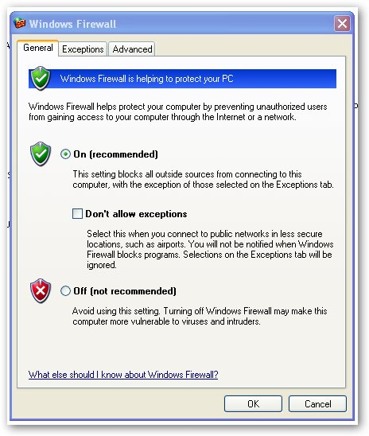
Personal Firewall
Detects and protects a computer from unauthorized intrusions

Slide 23
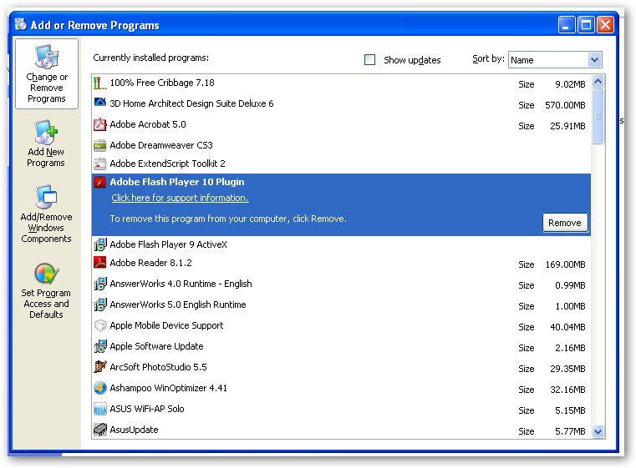
Uninstaller
Removes programs from the operating system.

Slide 24
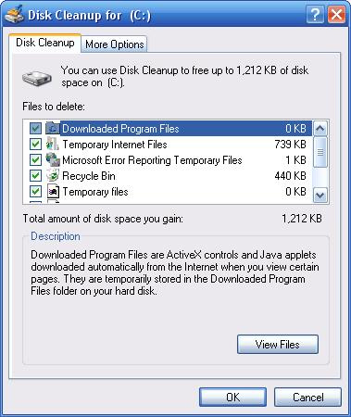
Disk Cleanup
A program that scans for unnecessary files
It then gives you the option to remove the files.

Slide 25
Disk Fragmantation
When a hard drive is new files are stored in sequential blocks of data.
When files are deleted space is opened up on the hard drive
When new files are saved the bocks they contain fill in the hard drive starting from the front of the drive.
The new files is now fragmented on the hard drive

Slide 26
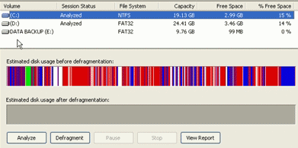
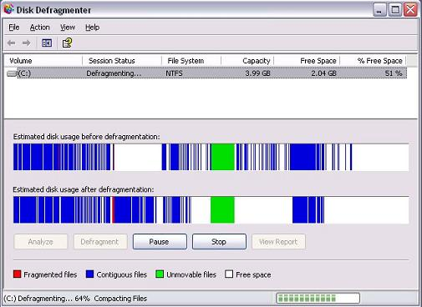
Disk Fragmantation
Over time the hard drive on a computer becomes extremely fragmented.
This will effect the speed at which the computer will work
To correct this problem you must defragment the hard drive.

